Slide 1
Congruent triangles (SAS)
Geometrical properties: similarity and Pythagoras' theorem

Slide 2
how to use Oak lessons

Slide 3
I can appreciate and use the criteria by which triangles are congruent (SAS).

Slide 4
If one shape can fit exactly on top of another using rotation, reflection or translation, then the shapes are congruent.

Slide 5

Congruent triangles (SAS)
Justifying congruence by SAS
Two sides and an angle

Slide 6
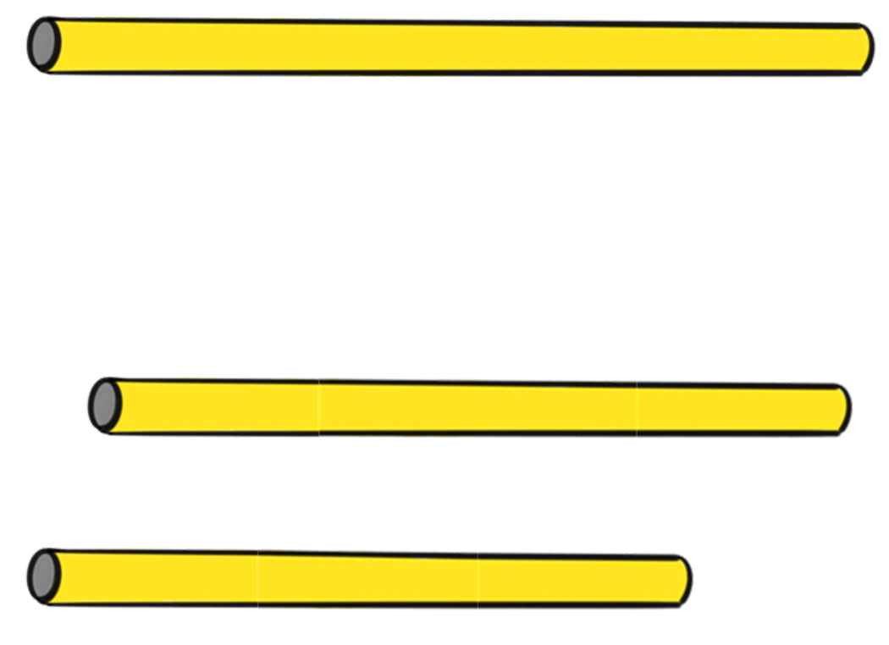
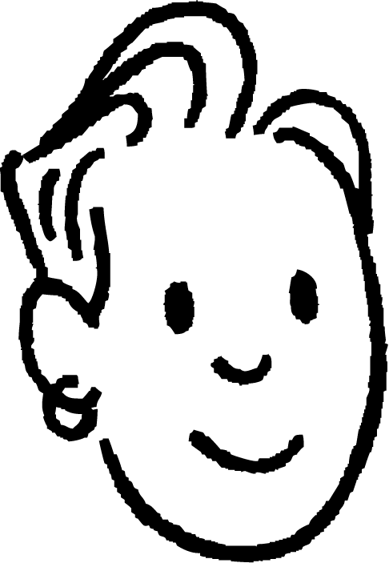
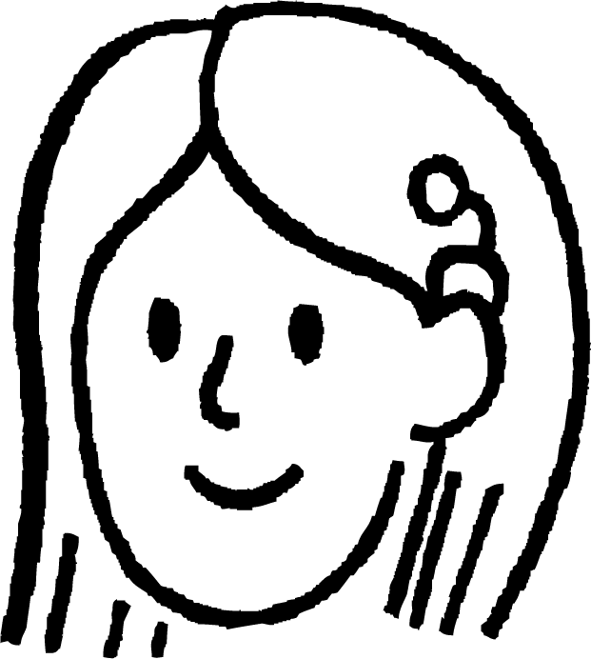

Justifying congruence by SAS
Jun, Sam and Sofia have three straws of various lengths and are creating triangles.
They know that they can only create one unique triangle with these three straw lengths.

Slide 7
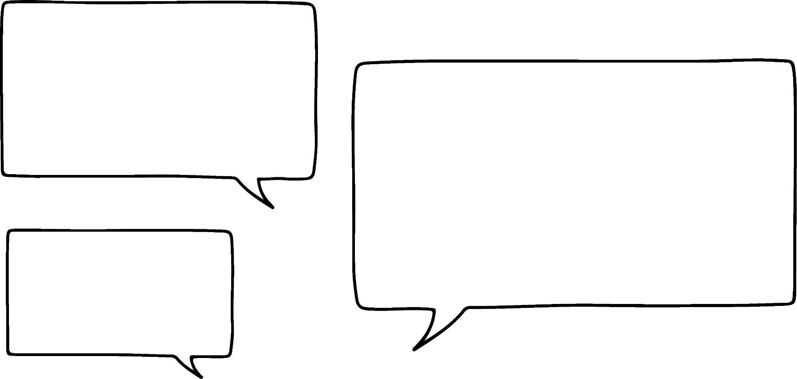
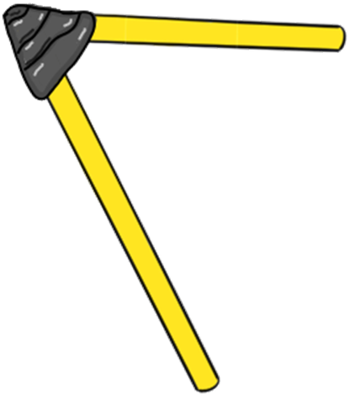
Justifying congruence by SAS
The straws are a fixed length though.
If we have two straws, taped into a fixed angle, how many different triangles can we make?
I think there would be a lot. There are many different right-angled triangles for instance.

Slide 8
Justifying congruence by SAS
Even if you fixed one side length, you would still get an infinite amount of triangles.
If the straws could be any length, but the angle is fixed, then lots of different triangles would be created?
Yes! I think we can show it through a construction.
🖇 SAS

Slide 9
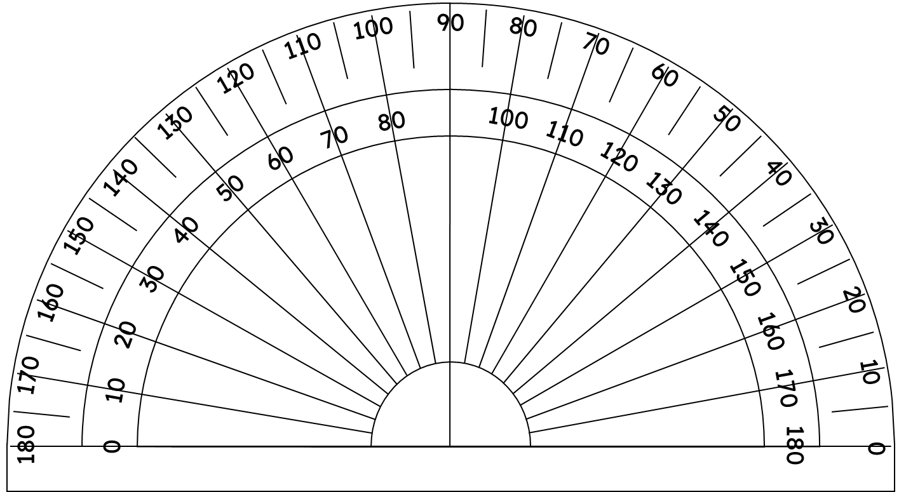
Justifying congruence by SAS
If the angle between two edges is fixed at 50°, we can draw the legs as rays, starting from point A.
50°
A

Slide 10
Justifying congruence by SAS
A point on each of the rays, can be joined to create a triangle.
There are an infinite number of possible triangles.
C
C
C
50°
A
B
B
B

Slide 11
Justifying congruence by SAS
What happens if we fix one of the lengths of the triangle? Let’s fix AC to be 7 cm. B can still go anywhere on the ray.
There are still an infinite number of possible triangles.
C
7 cm
50°
A
B
B
B

Slide 12
Justifying congruence by SAS
What happens if we fix one of the lengths of the triangle? This time BC is set to be 5 cm.
This still leads to an infinite amount of possible triangles.
C
C
C
5 cm
5 cm
5 cm
50°
A
B
B
B
🖇 Fixed opposite edge

Slide 13
Justifying congruence by SAS
We know that if we fix the two lengths, that are the legs of the angle, then we can only construct one triangle.
C
7 cm
5.6 cm
50°
A
B
6.2 cm
🖇 Two fixed edges

Slide 14

Justifying congruence by SAS
When constructing, which of these conditions will always lead to one fixed triangle?
8.6 m
8.6 m
3 m
3 m
73°
88°
9 m
9 m

Slide 15
Justifying congruence by SAS
Two triangles can be proved to be congruent if the corresponding edges are the same. We say they are congruent by SSS (side-side-side).
The angle opposite is therefore fixed too.
C
If we know two edges and the angle between them there is only one possible triangle that can be made.
All triangles with the same SAS will be congruent.
7 cm
5.6 cm
50°
A
B
6.2 cm

Slide 16
Justifying congruence by SAS
This means that two triangles can be proved to be congruent by SAS (side-angle-side) as well.
A
P
2.4 cm
5.3 cm
2.4 cm
89°
5.3 cm
89°
B
R
C
Q
For these two triangles, we can see that AB = PR, ∠BAC = ∠QPR and AC = PQ, hence these triangles are congruent by SAS.

Slide 17
Justifying congruence by SAS
This means that two triangles can be proved to be congruent by SAS (side-angle-side) as well.
A
X
2.4 cm
5.3 cm
2.4 cm
89°
5.3 cm
89°
B
Z
C
Y
For these two triangles, we can see that AB = XZ, AC = XY and ∠BAC = ∠XZY, however these two triangles are not congruent. The 89° is not between the two known edges in both triangles.

Slide 18
Justifying congruence by SAS
Are these triangles congruent to each other?
V
M
6.8 cm
6.1 cm
63°
63°
O
6.8 cm
6.1 cm
68°
T
49°
N
U
Yes, ∠TVU = 180 - (68 + 49) = 63°, so triangle MNO is congruent to triangle TVU by SAS.

Slide 19
Justifying congruence by SAS
Using known properties of shapes, it is possible to prove triangles are congruent by SAS.
Prove triangle ABC is congruent to triangle ACD, given that ABCD is a rhombus.
A
D
AB = CD as they are edges of a rhombus.
∠ABC = ∠ADC as they are opposite angles in a rhombus.
AD = BC as they are edges of a rhombus.
Hence, triangle ABC is congruent to triangle ACD by SAS.
B
C

Slide 20
Justifying congruence by SAS
Given that ABCD is a rhombus, prove triangle ABC is congruent to triangle ACD.
A
D
AB = CD as they are edges of a rhombus.
∠DAC = ∠ACB as they are
AC is a shared edge on both triangles.
Hence, triangle ABC is congruent to triangle ACD by SAS.
interior alternate
B
C
angles in parallel lines
Fill the blank.

Slide 21
Justifying congruence by SAS
1) Construct the following triangles:
a) Triangle ABC, where AB = 6 cm, BC = 9 cm and ∠ABC = 42°
b) Triangle PQR, where PQ = 6 cm, QR = 9 cm and ∠QPR = 42°
2) Measure the edges and angles in the two triangles constructed in question 1. Are they congruent triangles?

Slide 22
Justifying congruence by SAS
3) Prove triangle ABC is congruent to triangle PQR by SAS.
A
P
32°
3.9 cm
128°
3.9 cm
20°
C
Q
R
B
3.9 cm
3.9 cm
4) Given a parallelogram ABCD, prove that triangle ABC is congruent to triangle ACD by SAS.

Slide 23
Justifying congruence by SAS
1) Construct the following triangles:
a) Triangle ABC, where AB = 6 cm, BC = 9 cm and ∠ABC = 42°
C
9 cm
42°
B
6 cm
A

Slide 24
Justifying congruence by SAS
b) Triangle PQR, where PQ = 6 cm, QR = 9 cm and ∠QPR = 42°
R
9 cm
42°
P
6 cm
Q

Slide 25
Justifying congruence by SAS
2) Measure the edges and angles in the two triangles constructed in question 1. Are they congruent triangles?
Triangle ABC:
AB = 6 cm
BC = 9 cm
AC = 6.1 cm
∠ABC = 42°
∠BAC = 96.6°
∠ACB = 41.4°
Triangle PQR:
PQ = 6 cm
QR = 9 cm
PR = 12.5 cm
∠QPR = 42°
∠PQR = 111.5°
∠PRQ = 26.5°
No they are not congruent.

Slide 26
Justifying congruence by SAS
3) Prove triangle ABC is congruent to triangle PQR by SAS.
A
P
32°
3.9 cm
128°
3.9 cm
128°
20°
C
Q
R
B
3.9 cm
3.9 cm
The interior angles of a triangle sum to 180°, therefore ∠PQR = 180 - (32 + 20) = 128°.
AB = PQ, ∠ABC = ∠PQR and BC = QR, so triangle ABC is congruent to triangle PQR by SAS (side-angle-side).

Slide 27
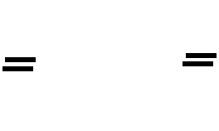
Justifying congruence by SAS
4) Given a parallelogram ABCD, prove that triangle ABC is congruent to triangle ACD by SAS.
A
D
AD = BC as opposite edges on a parallelogram are equal in length.
∠ABC = ∠ADC as opposite angles in a parallelogram are equal in size.
B
C
AB = DC as opposite edges on a parallelogram are equal in length.
Hence, triangle ABC is congruent to triangle ACD by SAS.

Slide 28
Justifying congruence by SAS
4) Given a parallelogram ABCD, prove that triangle ABC is congruent to triangle ACD by SAS.
A
D
AD = BC as opposite edges on a parallelogram are equal in length.
∠DAC = ∠ACB as they are equal interior alternate angles.
B
C
AC is a shared side.
Hence, triangle ABC is congruent to triangle ACD by SAS.

Slide 29
Congruent triangles (SAS)
Justifying congruence by SAS
Two sides and an angle

Slide 30
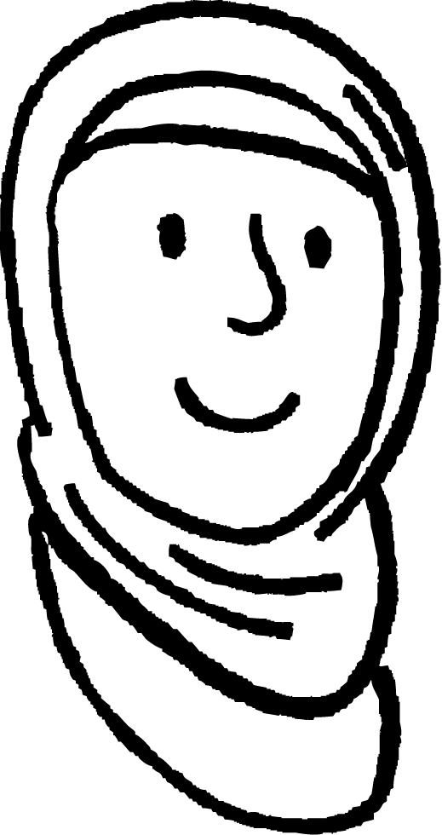
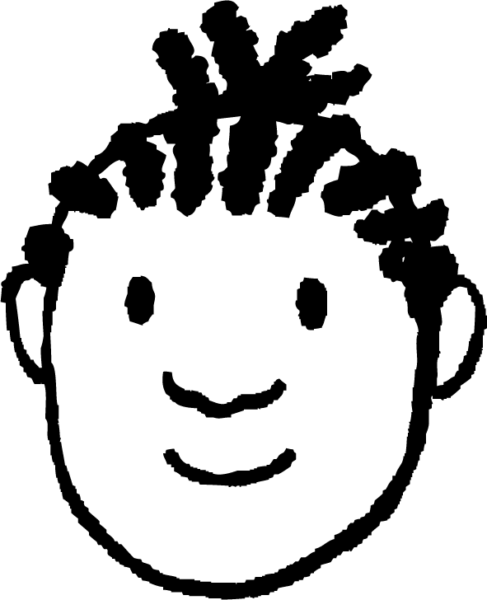
Two sides and an angle
Aisha and Jacob are discussing the amount of information you need to prove two triangles are congruent to each other.
c
b
r
q
a
p
If you only know the three corresponding edge lengths are equal, then you can prove they are congruent by SSS.
Yes, the angles are fixed by the edge lengths. SSS!

Slide 31
Two sides and an angle
Aisha and Jacob are discussing the amount of information you need to prove two triangles are congruent to each other.
A
P
c
b
r
q
If you know two corresponding sides and the angle between them, then you can prove the two triangles are congruent.
Yes, by SAS (side-angle-side)!

Slide 32
Two sides and an angle
Aisha and Jacob are discussing the amount of information you need to prove two triangles are congruent to each other.
b
q
B
Q
a
p
Do these two corresponding sides and angle, prove they are congruent to each other?
I’m not sure? Let’s look at an example.

Slide 33
Two sides and an angle
These two triangles both have a 50° angle, an edge that is 5 cm and an edge that is 6 cm, but they are not congruent.
5 cm
5 cm
50°
6 cm
50°
6 cm

Slide 34
Two sides and an angle
These two triangles, have the same angle and two edges of the same length, but they are not congruent.
This is due to the circle with radius 5 cm, intersecting with the ray at two distinct points.
5 cm
5 cm
Knowing two sides and an angle is not enough to prove congruence. The angle must be between the two known sides.
50°
6 cm
🖇 SSA

Slide 35
Two sides and an angle
Congruent by SSS
Congruent by SAS
c
b
b
c
c
c
B
B
a
a
a
a
So we need a minimum of three pieces of information and one from each pair of side and angles
But they have to be the corresponding pairs on each triangle.

Slide 36
Two sides and an angle
Here are two triangles, triangle MNO and triangle XYZ. Are they congruent to each other?
M
X
8 cm
8 cm
79°
22°
79°
22°
N
Y
8 cm
O
Z
8 cm
The given angle is not between the two known sides, so it does not satisfy SAS.
Can you calculate the angle between them?
Yes, it is an isosceles triangle.

Slide 37
Two sides and an angle
The circle with radius of 8 cm, centred at O, intersects with the ray starting at N at 79° to NO two times, except one of the intersections, doesn’t create a triangle.
M
This is an example of a special case where SSA would create a fixed triangle. Since the triangle is isosceles all other angles can be found. So the conditions also confirm SAS.
8 cm
79°
N
8 cm
O

Slide 38
Two sides and an angle
Which three pieces of information is sufficient to prove congruence of two triangles?
All angles confirm similarity but not congruence
All three angles
All three sides
Two sides and the angle between them
SSA on its own doesn’t guarantee congruence.
Two sides and another angle

Slide 39
Two sides and an angle
1) Which of the following triangles are definitely congruent to the triangle XYZ?
D
A
X
3.4 cm
6.8 cm
3.4 cm
3.4 cm
68°
81°
81°
81°
E
B
C
F
Y
Z
6.4 cm
M
6.4 cm
J
G
3.4 cm
68°
68°
3.4 cm
68°
81°
N
O
31°
6.4 cm
31°
K
L
H
I
6.4 cm

Slide 40

Two sides and an angle
1) Which of the following triangles are definitely congruent to the triangle XYZ?
A
D
X
3.4 cm
6.8 cm
68°
3.4 cm
3.4 cm
81°
81°
81°
B
C
E
F
Y
6.4 cm
Z
6.4 cm
M
J
G
3.4 cm
68°
68°
3.4 cm
68°
81°
N
31°
O
31°
K
L
6.4 cm
H
I
6.4 cm

Slide 41
Congruent triangles (SAS)
Two triangles can be proved to be congruent if the two side lengths and the angle between them are the same.
If two side lengths and an angle, not between them, are known, this does not prove congruence. There can be two triangles with these details.

Slide 42

© Oak National Academy 2024.
Produced in partnership with Mathematics in Education and Industry.
Licensed on the Open Government Licence v3.0, except where otherwise stated. See Oak terms and conditions.

